Slide 1
The royal family
Made by: Lucas and Gijs

Slide 2
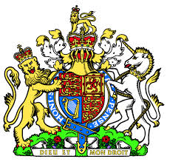
Why do they have a royal family
- Constitutional monarchy (1689)
- There's a queen

Slide 3
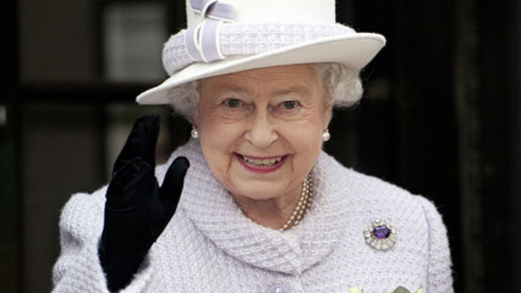
What powers does the queen have?
- Right to rule (subjects not citizens)
- Focus on nation unity
- Politically neutral
- Dissolve the parliament
- Highest military command

Slide 4
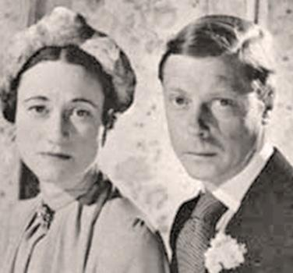
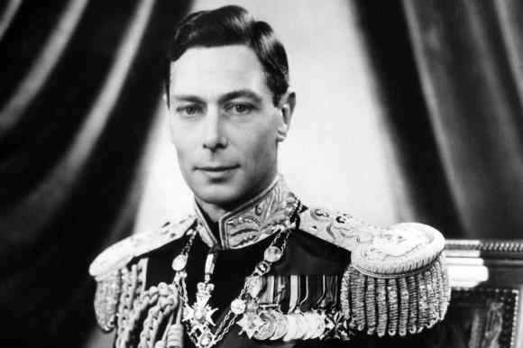
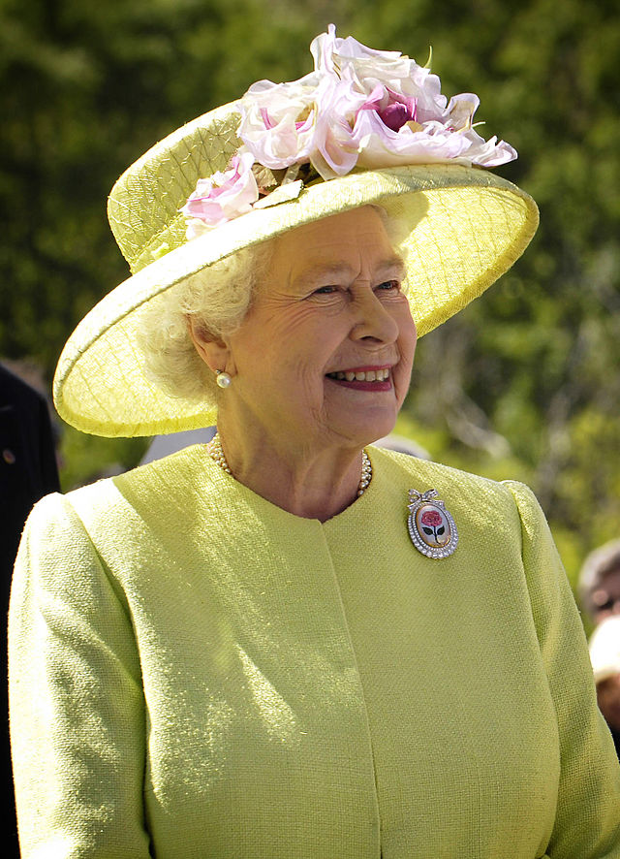
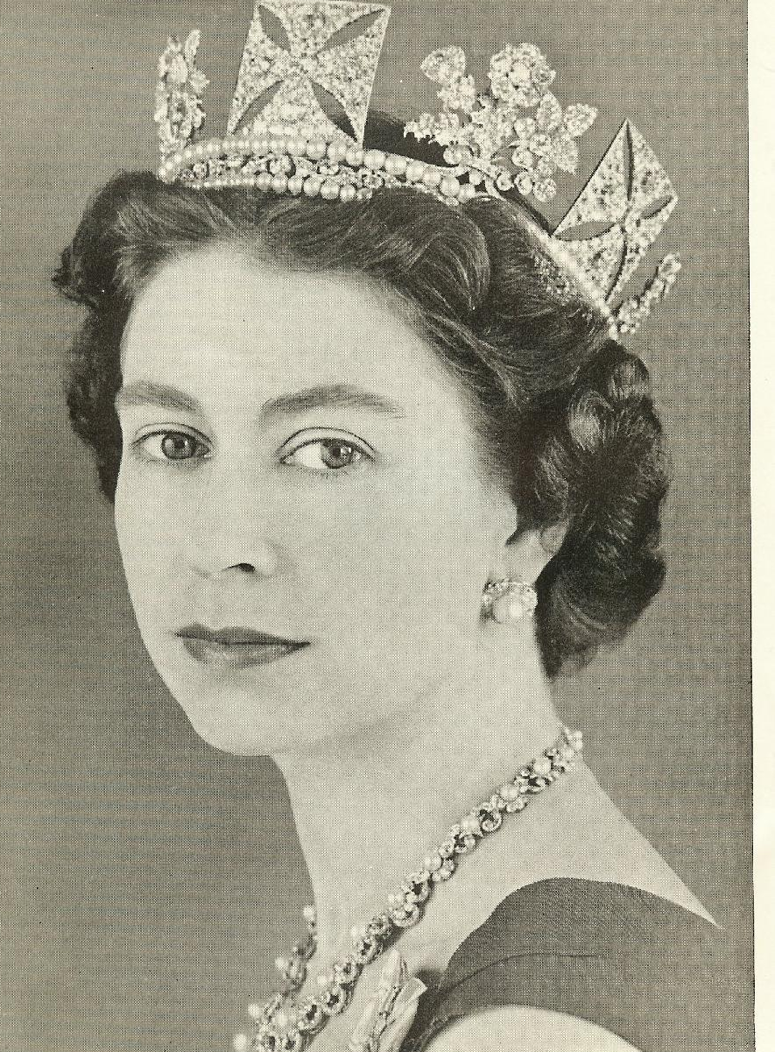
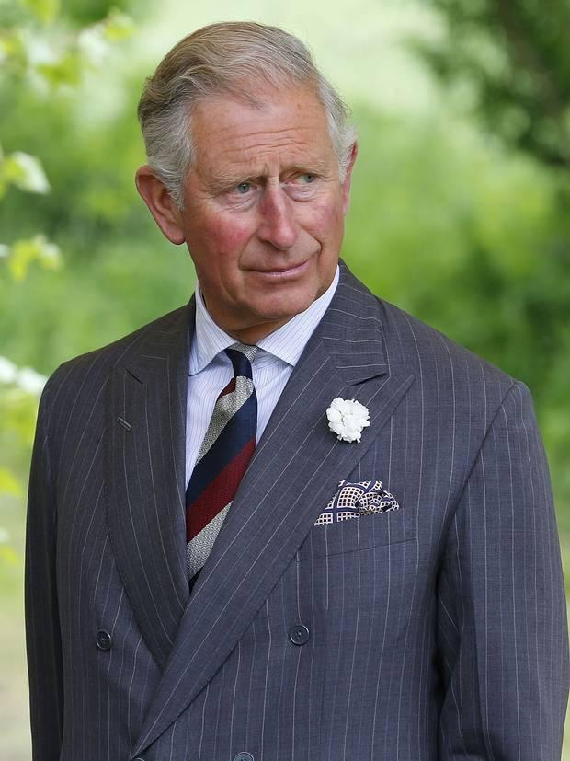
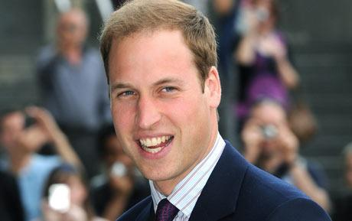
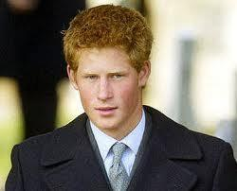
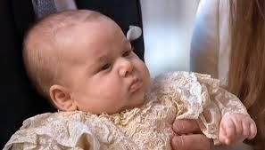
How did Queen Elizabeth become the English monarch? &
Who will become the next monarch when the Queen dies?
edward VIII
george VI
wallis simpson
camilla parker bowles
brother of George VI, married a divorced american woman.
Was king, died in 1952, father of Elizabeth
would become queen if Elizabeth died before she had children or was crowned
charles
william
henry
george alexander

Slide 5
bronnen
http://nl.wikipedia.org/wiki/Elizabeth_II_van_het_Verenigd_Koninkrijk#Geboorte_en_jeugd
https://www.youtube.com/watch?v=BUY6HGqYweQ
http://www.theguardian.com/world/2002/may/16/qanda.jubilee
https://uk.answers.yahoo.com/question/index?qid=20110427172646AAnesIi

